Slide 1
Fuel Plugins for ScaleIO
EMC {Code}

Slide 2
Agenda
Fuel Plugin Definitions
Fuel Plugin ScaleIO Cinder
Fuel Plugin ScaleIO (OpenStack HA)
Resources

Slide 3
Fuel Plugins for ScaleIO
Fuel plugin ScaleIO Cinder is targeted to OpenStack environments that want to take advantage of an existing ScaleIO deployment.
Fuel plugin ScaleIO is targeted for a new ScaleIO deployment on an OpenStack cluster in a High Availability (HA) configuration.

Slide 4
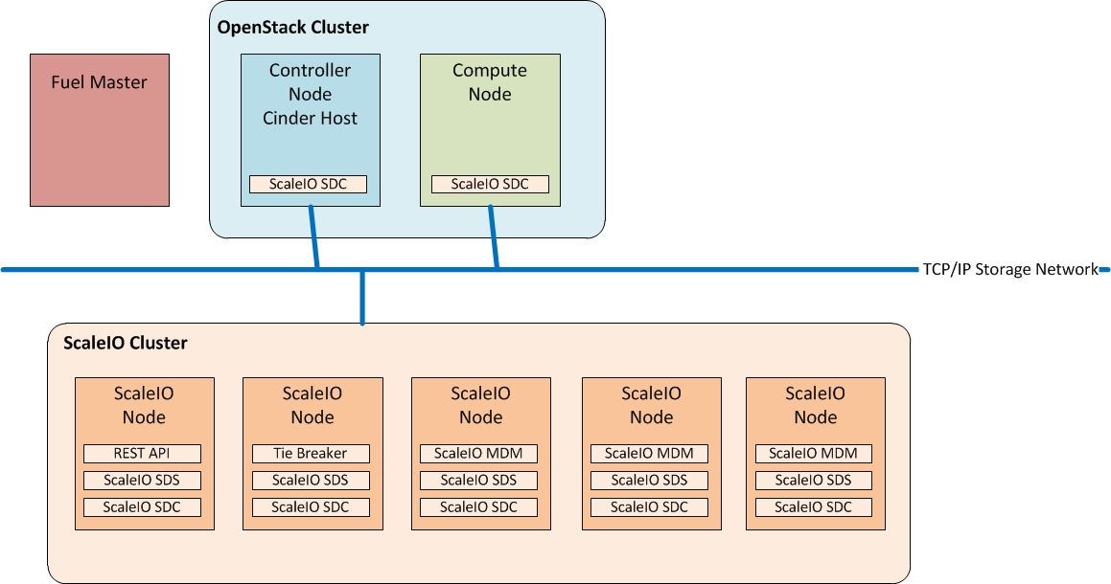
Fuel Plugin ScaleIO Cinder
Only the ScaleIO SDC service needs to run on the Controller Nodes and Compute Nodes
Controller Node + Cinder Host: A node that runs network, volume, API, scheduler, and image services. Each service may be broken out into separate nodes for scalability or availability. In addition this node is a Cinder Host, that contains the Cinder Volume Manager OpenStack Cluster
Compute Node: A node that runs the nova-compute daemon that manages Virtual Machine (VM) instances that provide a wide range of services, such as web applications and analytics. OpenStack Cluster

Slide 5
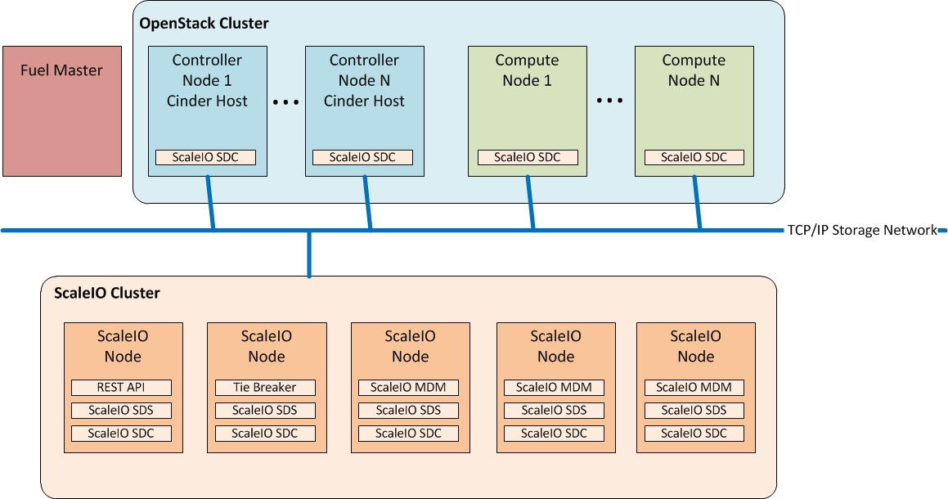
Fuel Plugin ScaleIO Cinder (scaling Out)
As Controller and Computes nodes increase, the ScaleIO SDC service is deployed as apart of these Roles.
Installation: https://github.com/emccode/fuel-plugin-scaleio-cinder-test#scaleio-cinder-plugin-installation
Configuration: https://github.com/emccode/fuel-plugin-scaleio-cinder-test#scaleio-cinder-plugin-configuration

Slide 6
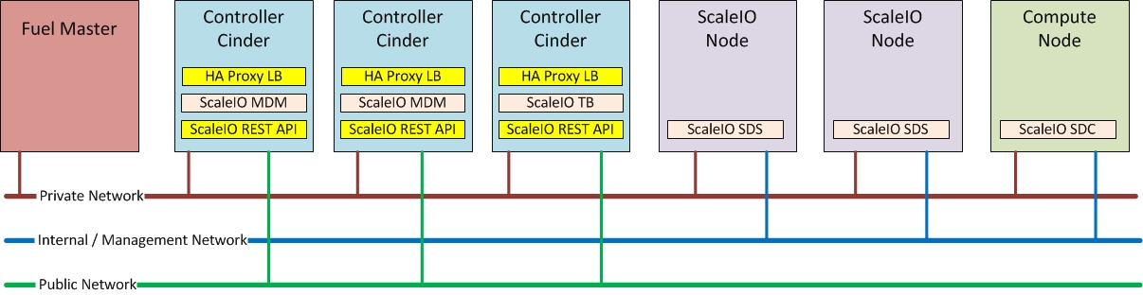
Fuel Plugin ScaleIO (OpenStack HA)
OpenStack High Availability (HA) deployment Recommendation to have 3 x Controller Nodes
Each Controller Node has 1 x ScaleIO REST API Service Load balanced by a HA Proxy Service (http://www.haproxy.org/ )
Rest of Services are distributed through the OpenStack Cluster
2 x ScaleIO Dedicated nodes are required to run HA ScaleIO SDS Service
Compute Nodes: All compute nodes will run the ScaleIO SDC Service
In Progress: https://github.com/emccode/fuel-plugin-scaleio

Slide 7
Resources
• Fuel plugin ScaleIO Cinder:
Code repository: https://github.com/emccode/fuel-plugin-scaleio-cinder-test
Documentation: https://github.com/emccode/fuel-plugin-scaleio-cinder-test/blob/master/README.md
Releases are located here: https://github.com/emccode/fuel-plugin-scaleio-cinder-test/releases
This plugin is code complete, and will be tested by Mirantis this week for their blessing.
• Fuel plugin ScaleIO:
The repository is located here: https://github.com/emccode/fuel-plugin-scaleio
Documentation: In progress
Release: https://github.com/emccode/fuel-plugin-scaleio/releases

